Slide 1
Unemployment Rate Forecasting – A Time Series Analysis
Sabiha Khan - 915

Slide 2

Introduction
Time Series
Time series refers to a sequence of data points collected or recorded over a period of time.
Time Series Analysis
Analysing time series data in order to extract meaningful statistics and other characteristics of the data.
Time Series Forecasting
Estimating many future aspects of a business or other operation based on the current time series.

Slide 3
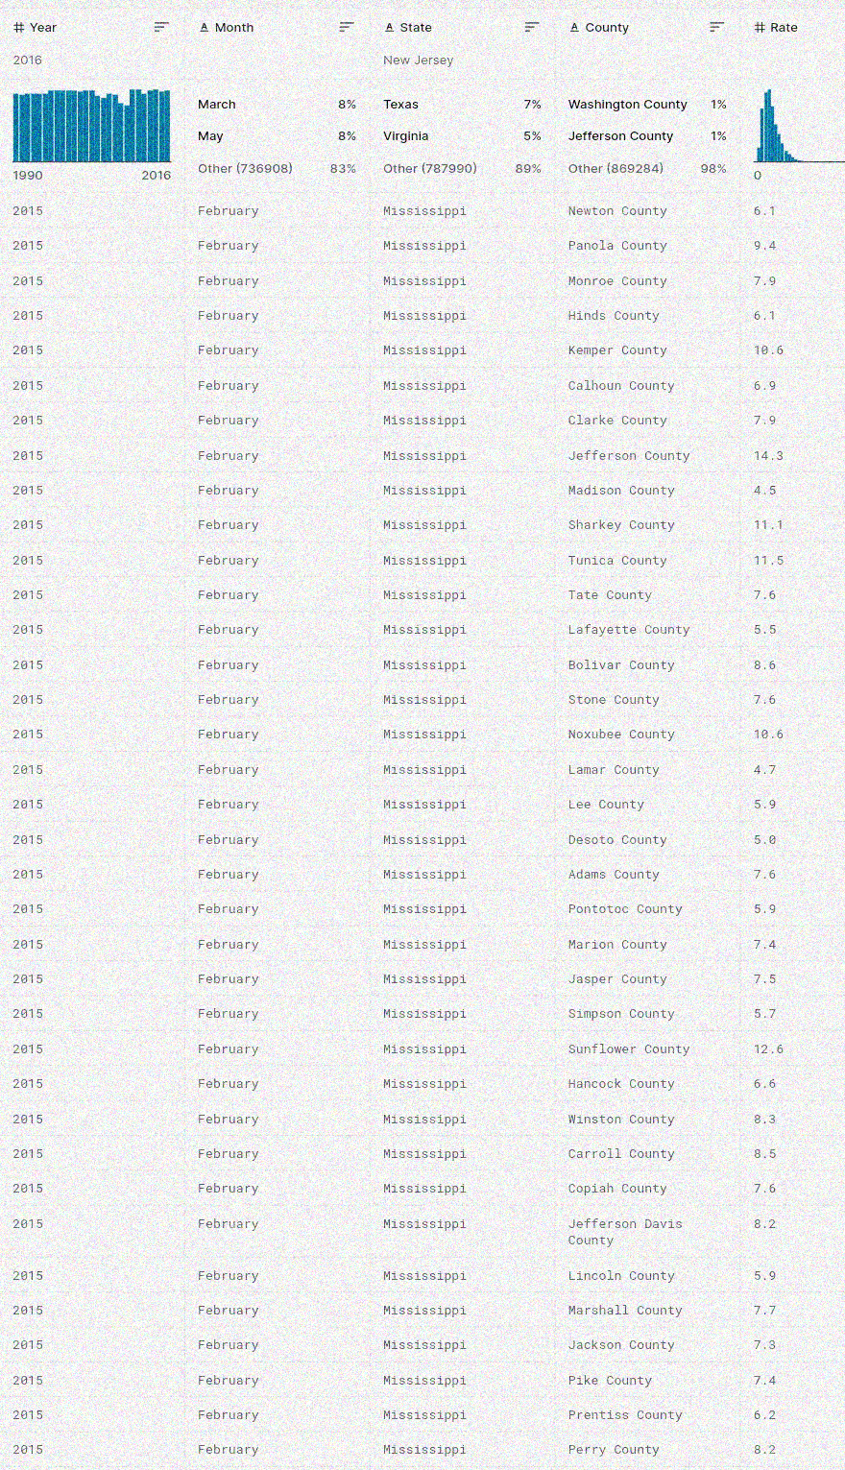
Data Snapshot

Slide 4
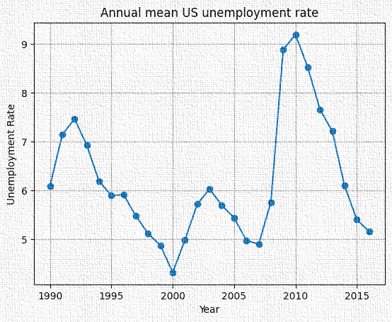
EDA

Slide 5
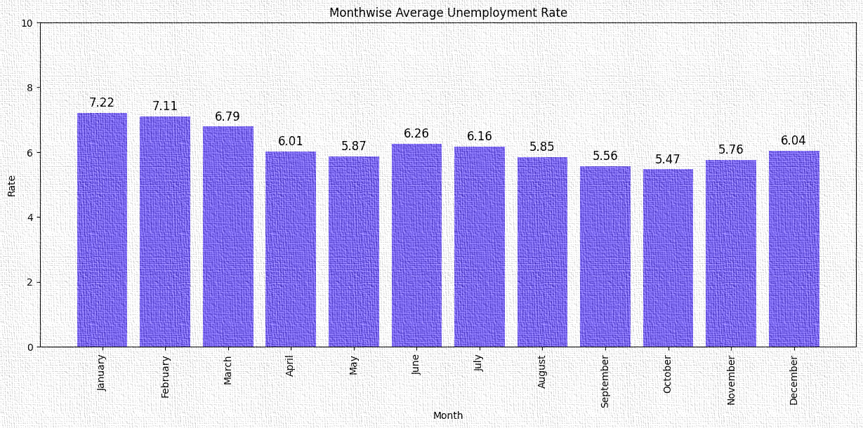
Monthwise Average Unemployment Rate

Slide 6
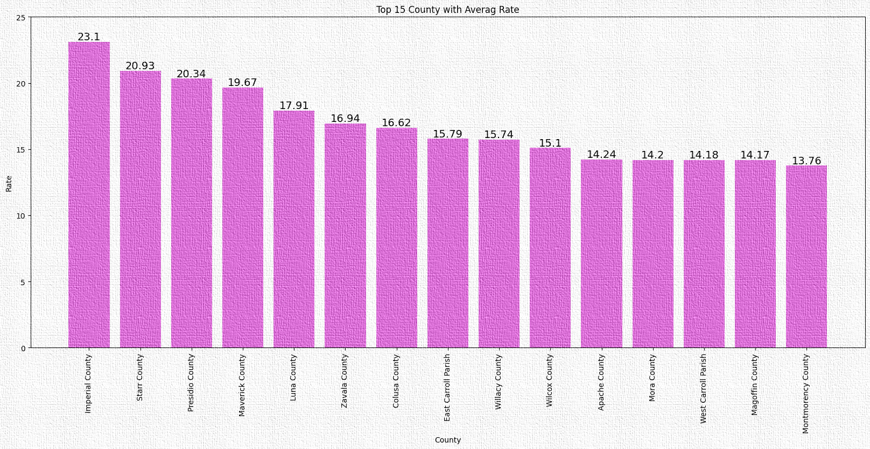
Top 15 County with Average Rate

Slide 7
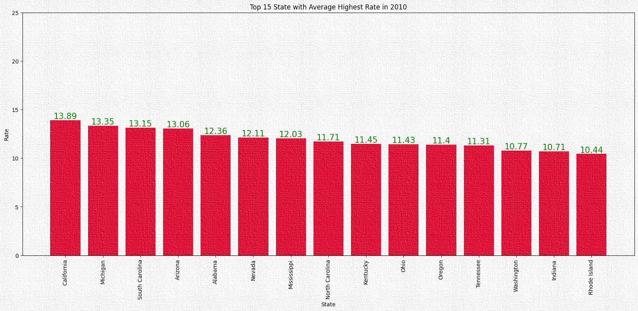
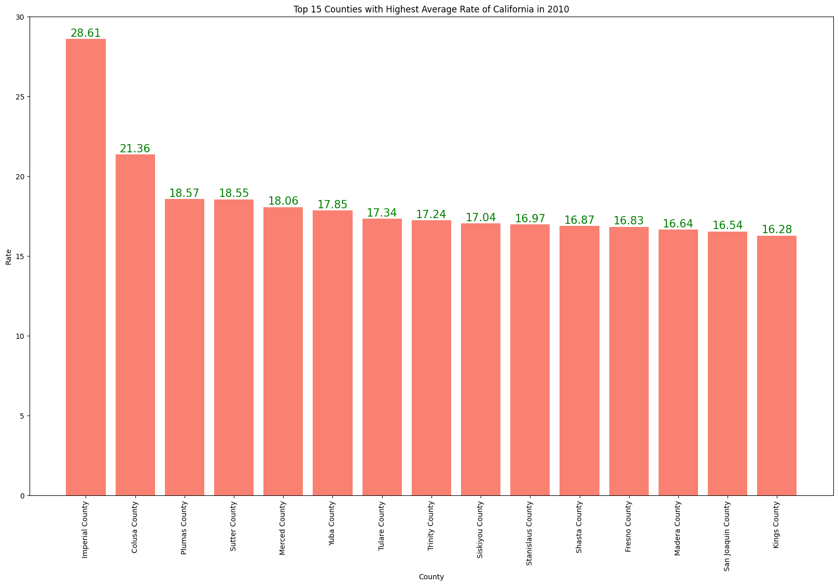
Top 15 State with Average Highest Rate in 2010
Top 15 Counties with Highest Average Rate of California in 2010

Slide 8
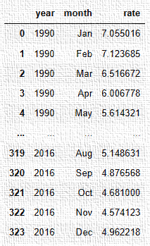
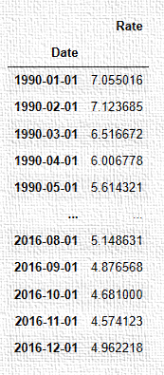
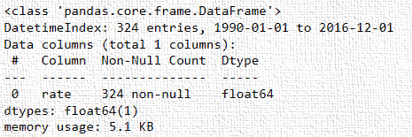
Preparing the dataset for analysis
Information about new dataset

Slide 9
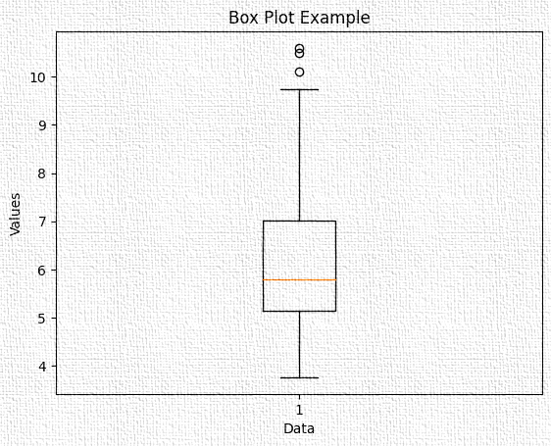
Checking For Outliers:

Slide 10
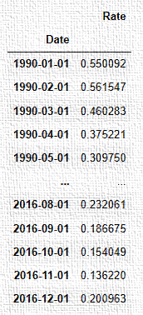
Min-Max Scaling
normalized_data = (data - min_vals) / (max_vals - min_vals)

Slide 11
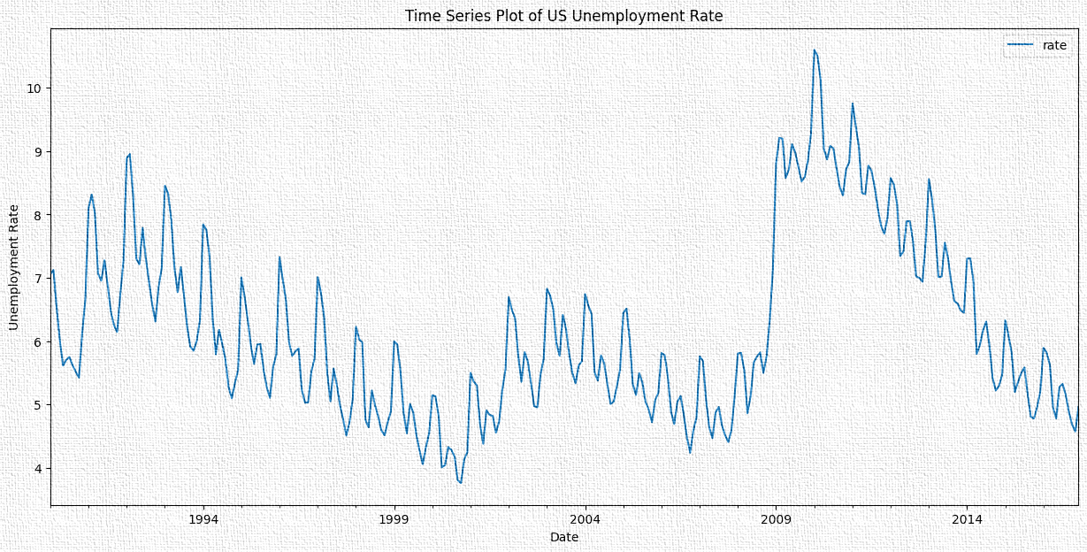
Yearly Plot

Slide 12
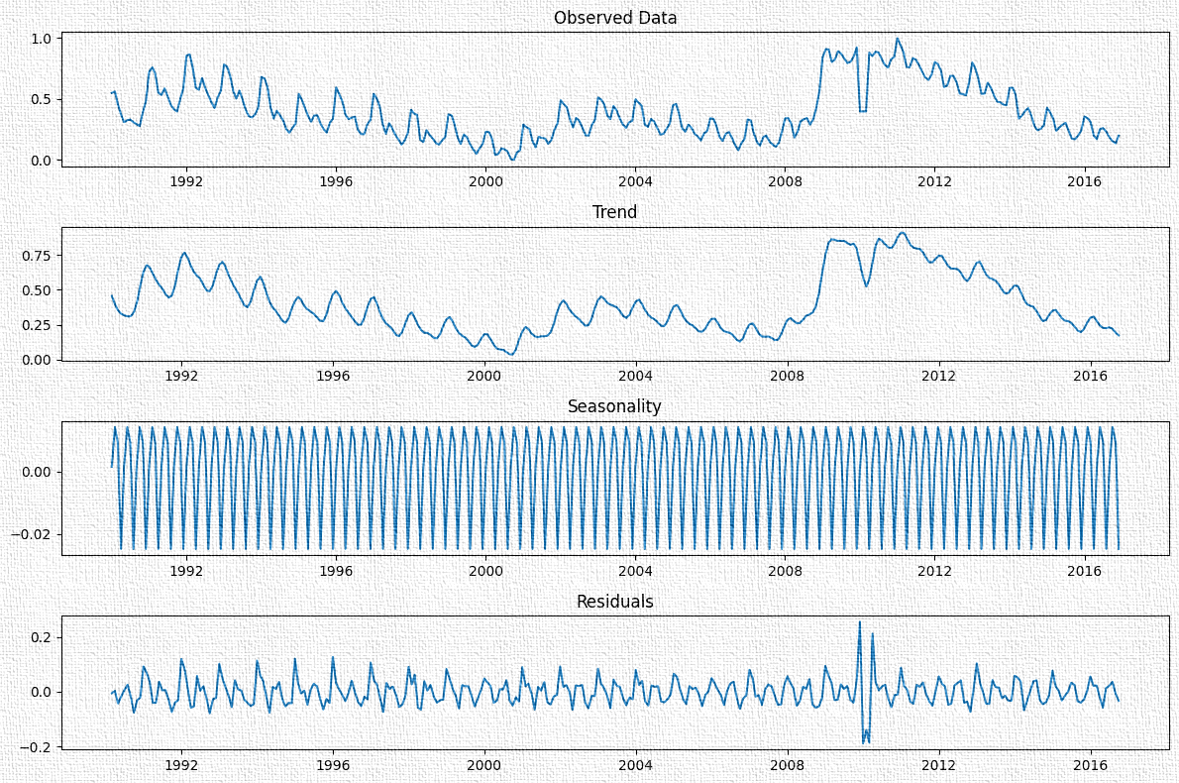
Seasonal Decomposition

Slide 13
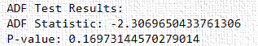
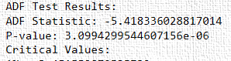
ADF Test for Stationarity
ADF Test:
First Differencing
After differencing once, the data is now Stationary.

Slide 14
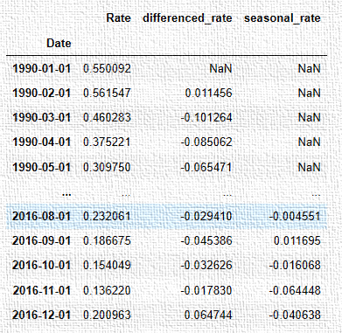
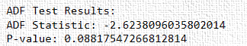
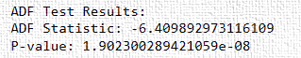
Handling Seasonal Data
ADF Test:
ADF Test:
First seasonal Differencing
After differencing once, the data is now
Stationary.

Slide 15
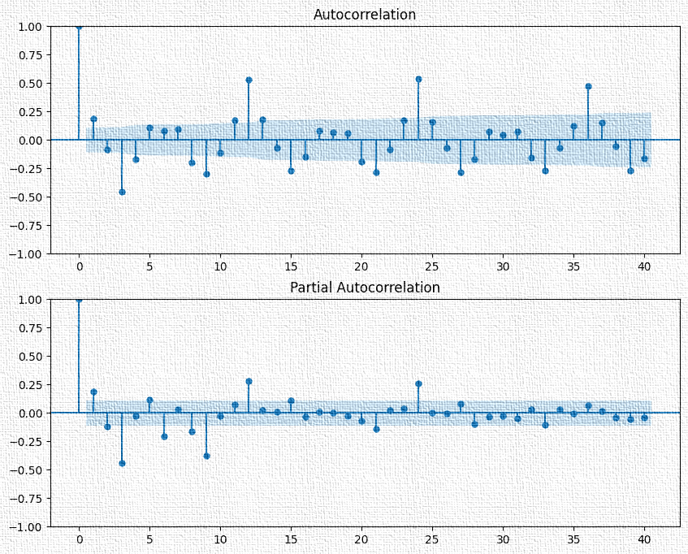
ACF and PACF Plots (Non-Seasonal)
(1,1,1)

Slide 16
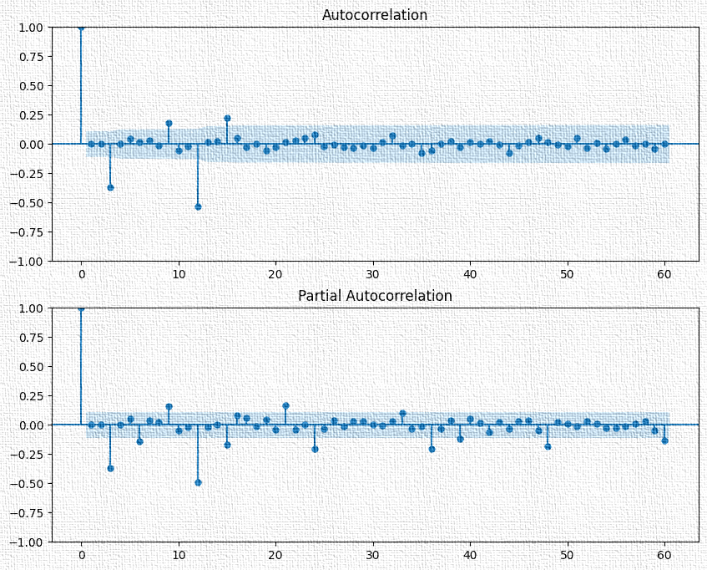
ACF and PACF Plots (Seasonal)
(1,1,1)(12)

Slide 17
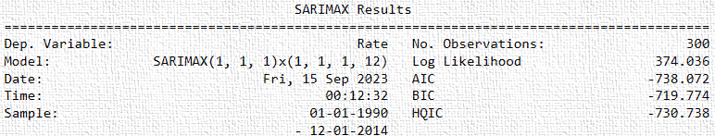
SARIMA modelling (1,1,1)(1,1,1,12):

Slide 18
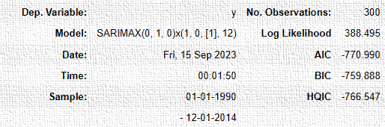
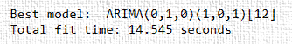
Auto-Arima

Slide 19
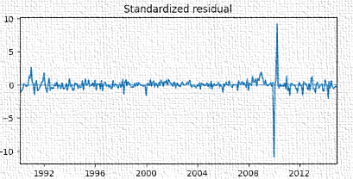
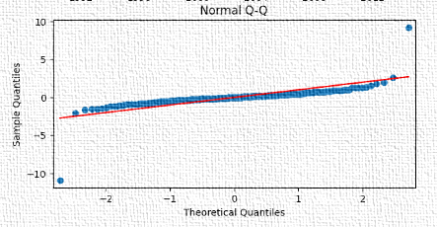
Residual Analysis

Slide 20
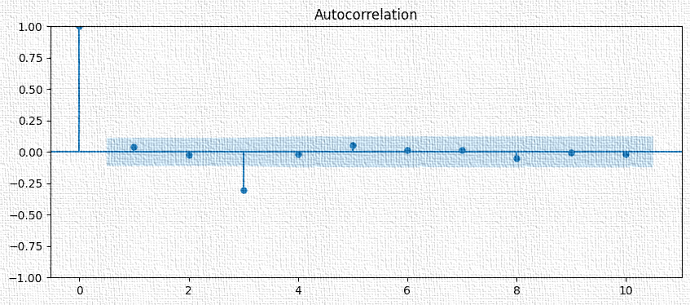
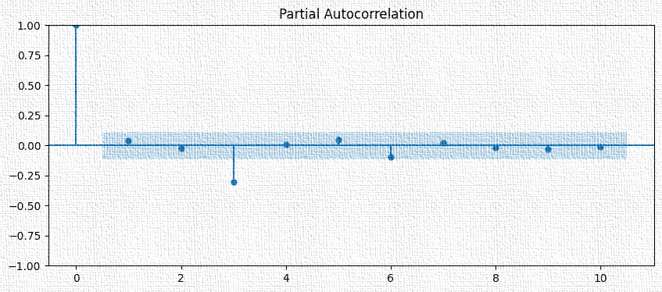
Plot of ACF and PACF of Residuals

Slide 21
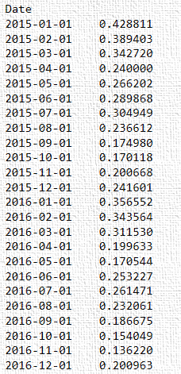
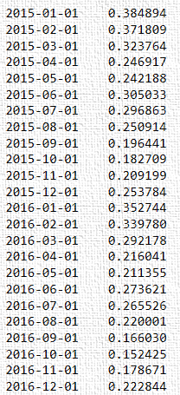
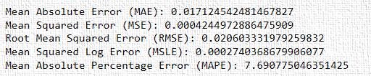
Performance Metrics
Test data
Forecast data

Slide 22
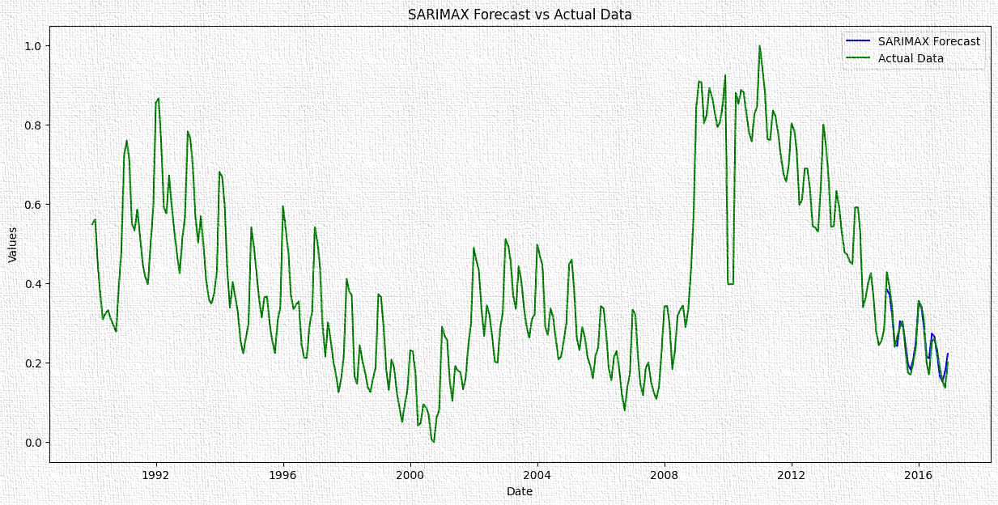

Slide 23
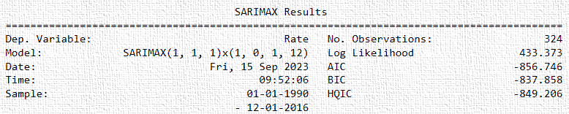
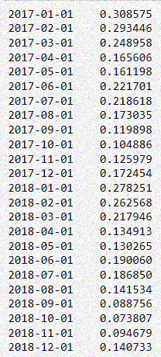
Final Model trained on the complete data
Future Forecast

Slide 24
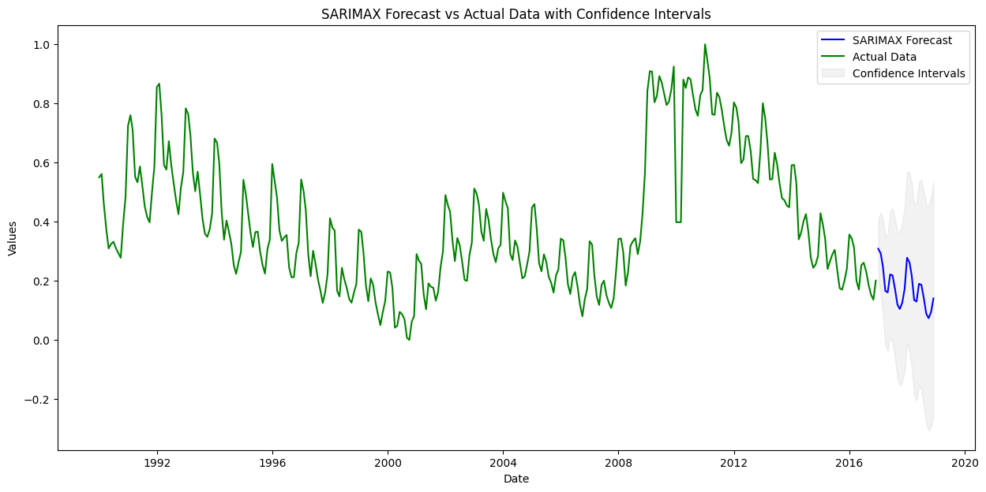

Slide 25
Summary
The time series is not stationary
It has a seasonal component and a trend and a cyclic component.
We used ADF Test to remove the trend and seasonal components from the series and found that SARIMA model (1,1,1)(1,1,1,12) model is a good fit for the remainder of the series.
We used the auto arima function to find a best fit ARIMA model and used it to forecast unemployment rate into 2017 and 2018.

Slide 26
Reference links
Time Series Analysis on US Unemployment Rate | Kaggle
Time Series Analysis and Forecasting | Data-Driven Insights (analyticsvidhya.com)

Slide 27
THANK YOU!

